Slide 1
A New Gaming Era
Notes:
This is a Silver Bullet presentation template for Account Managers. The notes on each slide inform you of which content needs to be replaced or filled in. Any text boxes with an * need to be replaced and any images with a ? need to be replaced.

Slide 2
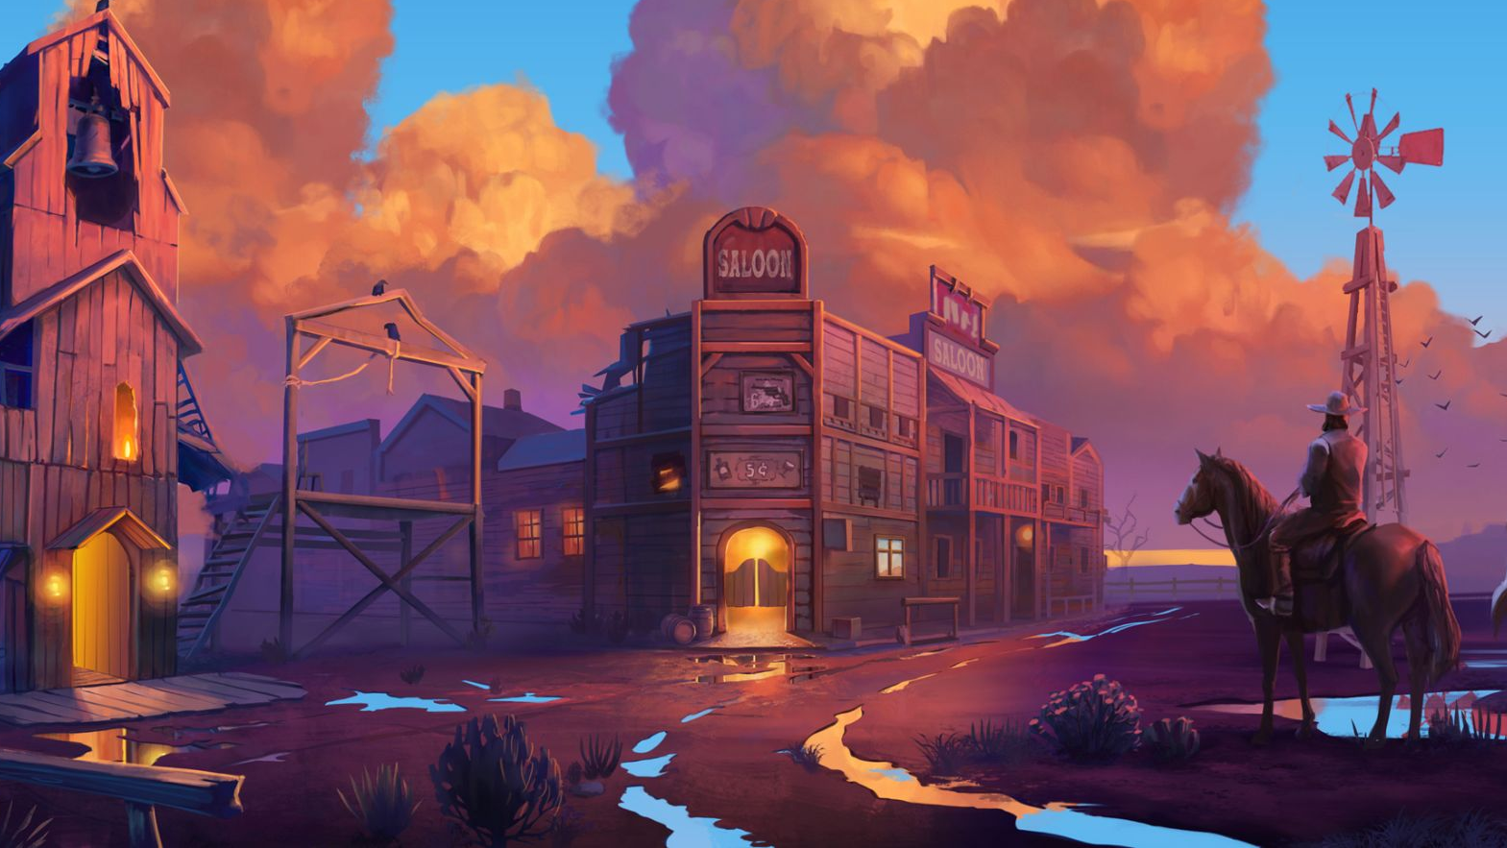
© Relax Gaming 2021
09/09/2021
Notes:
Replace:
Game name or logo
Studio logo
Release month and year e.g. January 2020

Slide 3
FEATURES
STATISTICS
10 lines
Volatility:
RTP: 96.16%
RTP Buy Free Spins: 97.11%
Max win (sim): 5000X
FreeSpins frequency: 1 in 202
Default min bet: 10 (0.1€)
Average feature win: 1 in 73.6x
Default max bet: 10000 (100€)
Game overview
Exiting Bonus wild symbol that get a randomized cash prize value each Free Spin.
Double Bonus Respin
Landing 2 Bonus Wild symbols in the base game activates a respin on the 3 remaining reels. Awarding both payout and additional chance to land a 3rd Bonus Wild.
Gatling Wheel
Spin the wheel 3 times to determine the Bonus wild’s price in the Showdown Free Spins.
Showdown Free Spins
Every Bonus Wild landed will award a cash price, laning 3 awards 2 additional free spins and another spin of the Gatling Wheel.
Notes:
Replace:
Unique selling point of your game
Feature names and brief explanations
Statistics:
Volatility
RTP
Feature frequency
Number of lines or ways
Max coinciding win
Default min and max bet

Slide 4
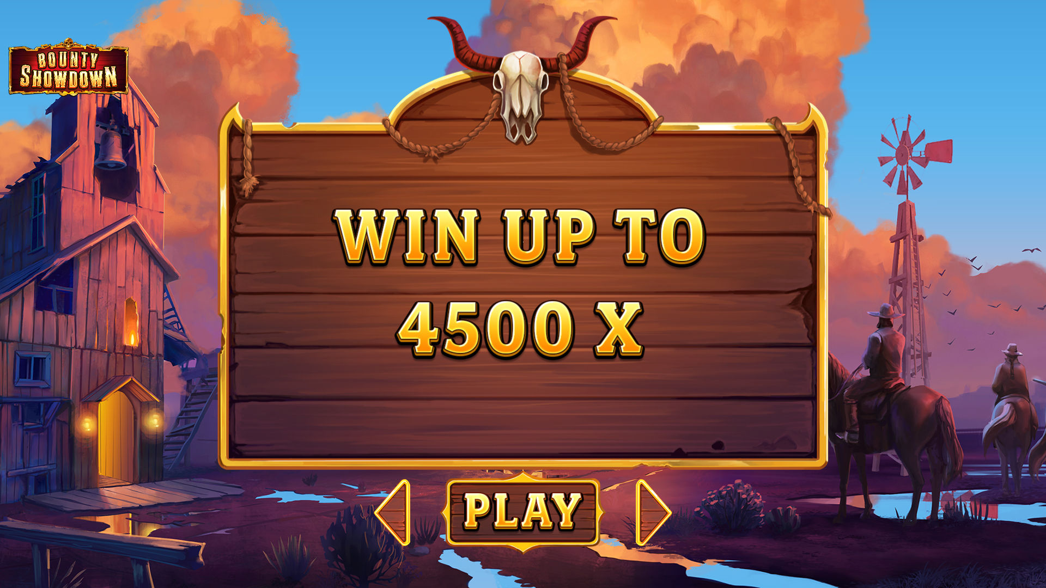
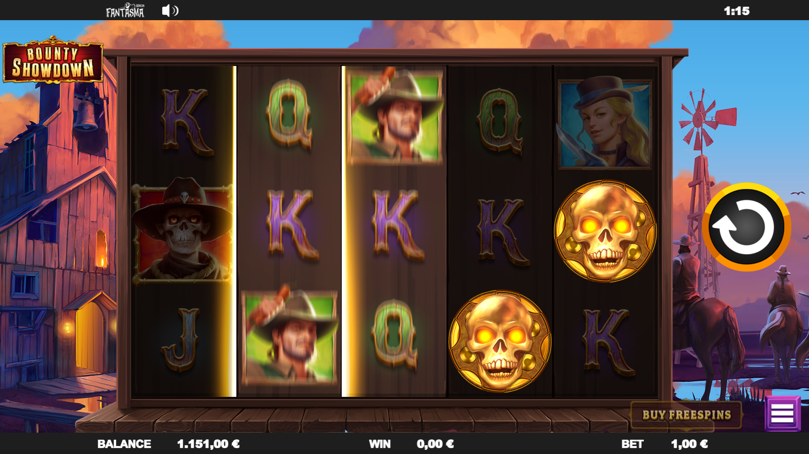
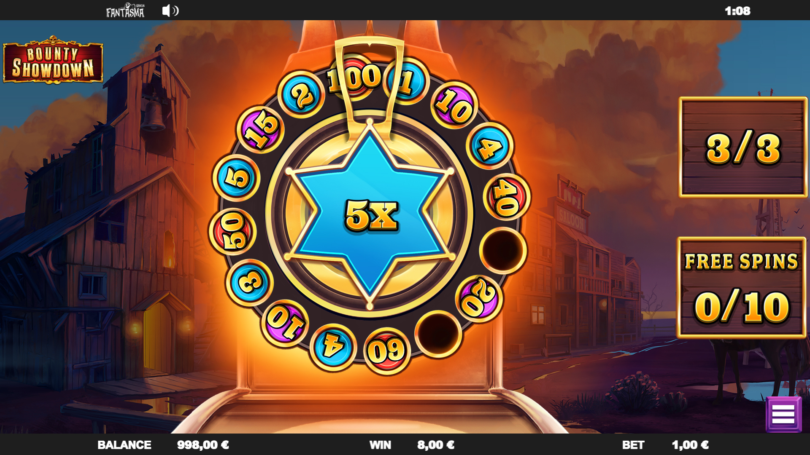
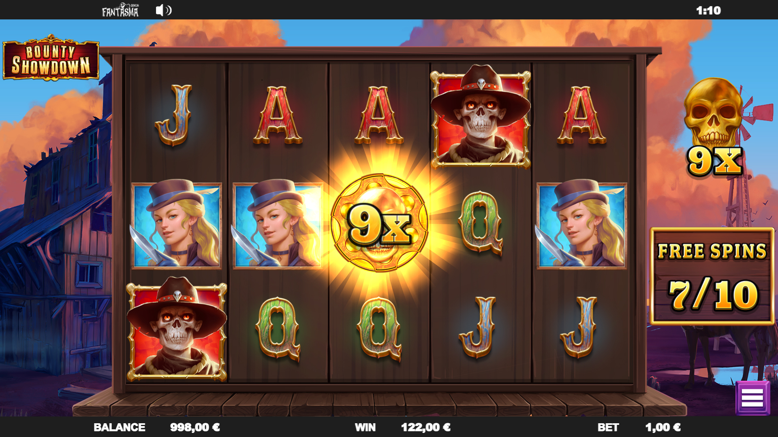
Game artwork
?
?
*Main game, feature or artwork
*Main game, feature or artwork
?
?
*Main game, feature or artwork
*Main game, feature or artwork
Notes:
Replace:
Screenshots and caption for either the main game, a feature or artwork - add, move or remove boxes as needed

Slide 5
Gameplay
Demo link
https://d2drhksbtcqozo.cloudfront.net/casino/launcher.html?channel=web&moneymode=fun&jurisdiction=MT&gameid=bountyshowdown
Video link
https://www.youtube.com/watch?v=MvgoGv1epwo
Notes:
Replace:
Demo URL link
Video URL link

Slide 6
A New Gaming Era

